Slide 1


A data-driven analysis for car accident characteristics in U.S. using Apache Spark
Gabriele Favia – matr. 579166
Big Data – Politecnico di Bari 19/20

Slide 2

The importance of driving safe
Car accidents are reportedly indicated by the statistics as one of the primary causes of death in the world ¹ with over 3 700 victims counted every day.
A data-driven analysis for car accident characteristics in U.S. using Apache Spark
Looking at the United States, the situation is not very different since over 37 000 people die in road crashes each year and an additional 2.35 million are injured or disabled.
Plus, regarding the economic side, road crashes cost the U.S. $ 230.6 billion per year or an average of $ 820 per person.
¹ Centers for Disease Control and Prevention
Gabriele Favia – matr. 579166
Big Data – Politecnico di Bari 19/20

Slide 3


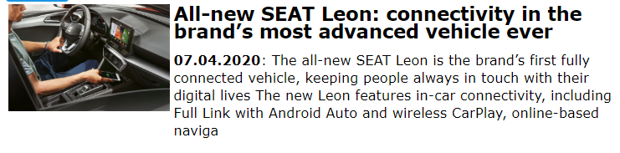

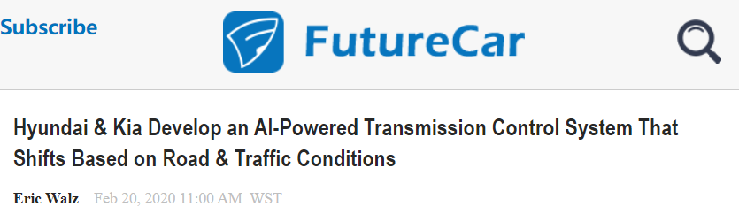
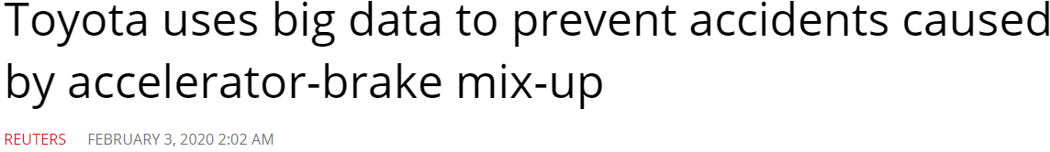
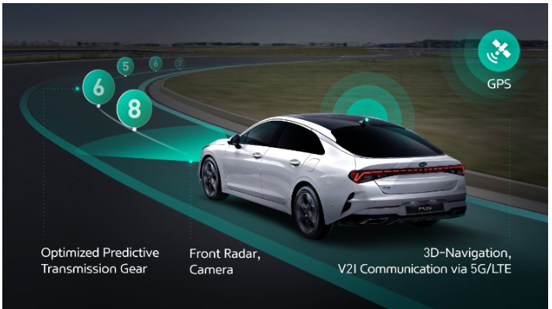
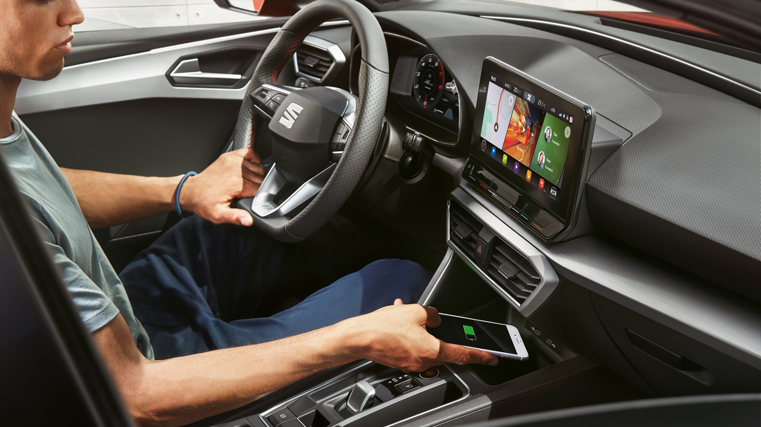

Improve on-board vehicle security with computer science
Notes:
Predictive Adaptive Cruise Control
Smart gear switch
accelerator suppression function

Slide 4



Objectives of the project
1) Analysing the dataset to get an idea of the external condition influencing the accidents, using this information to pre-process data for the model implementation.
2) Develop a data-driven model to predict the road danger assuming direct correlation with damage rate (“Severity”), taking into account external factors found in the first part of the project

Slide 5




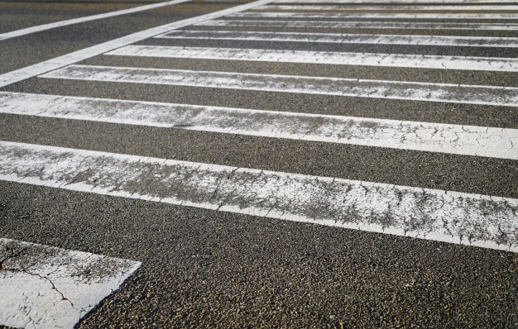

Materials
“US Accidents (3.0 million records)
A Countrywide Traffic Accident Dataset (2016 - 2019)”
Records: 2 974 335
Time coverage: 2016 Feb 01 to 2019 Dec 31
Size: ∼1 GB
Spatial coverage: United States
Python 2.7.17
Hadoop + YARN 3.1.1
Spark 2.4.5
DATA CLEANSING
FEATURE ENGINEERING
PIPELINING AND TRAINING
RESULTS

Slide 6
The Workflow
DATA CLEANSING
FEATURE ENGINEERING
PIPELINING AND TRAINING
RESULTS

Slide 7
DATA CLEANSING
Process of detecting and correcting (or removing) corrupt or inaccurate records from a dataset by replacing, modifying, or deleting the dirty or coarse data.
Drop malformed rows
Discard repetitions
FEATURE ENGINEERING
PIPELINING AND TRAINING
RESULTS

Slide 8
DATA CLEANSING
Creating new input features from existing ones.
It isolates and highlight key information, which helps algorithms to "focus" on what’s important.
Bucketing (grouping of the features)
Dealing with incomplete data
FEATURE ENGINEERING
PIPELINING AND TRAINING
RESULTS

Slide 9
DATA CLEANSING
Using the libraries provided by MLlib, data will be used to build a supervised model to predict street danger lever.
Data preparation
Pipelining
Training data
FEATURE ENGINEERING
PIPELINING AND TRAINING
RESULTS

Slide 10
The Workflow
DATA CLEANSING
Evaluation of the results of the processes of machine learning.
Accuracy
Time
Costs
FEATURE ENGINEERING
PIPELINING AND TRAINING
RESULTS

Slide 11



DATA CLEANSING
FEATURE ENGINEERING
PIPELINING AND TRAINING
RESULTS
Loading the dataset from storage
A data-driven analysis for car accident characteristics in U.S. using Apache Spark
ignores the whole
corrupted records.
DROPMALFORMED
returns a new DataFrame with duplicate rows removed.
DROPDUPLICATES

Slide 12
DATA CLEANSING
FEATURE ENGINEERING
PIPELINING AND TRAINING
RESULTS
Features of the dataset
City | Crossing | Railway | Severity | Start_Time | Precipitation(in) | Humidity(%)
County | Give_Way | Roundabout | Airport_Code | Start_Lat | Temperature(F) | Wind_Chill(F)
State | Traffic_Signal | Stop | Weather_Timestamp | Start_Lng | Street | Pressure(in)
Weather_Condition | Junction | No_Exit | TMC | Timezone | Distance(mi) | Visibility(mi)
ID | Bump | Nautical_Twilight | Sunrise_Sunset | End_Lat | Description | Wind_Direction
Source | Station | Turning_Loop | Civil_Twilight | End_Lng | End_Time | Side
Country | Traffic_Calming | Amenity | Astronomical_Twilight | Zipcode | Number | Wind_Speed(mph)
Notes:
49

Slide 13
Features of the dataset
City | Crossing | Railway | Severity | Start_Time | Precipitation(in) | Humidity(%)
County | Give_Way | Roundabout |  | Start_Lat | Temperature(F) | Wind_Chill(F)
State | Traffic_Signal | Stop |  | Start_Lng |  | Pressure(in)
Weather_Condition | Junction | No_Exit |  | Timezone |  | Visibility(mi)
 | Bump | Nautical_Twilight
Atmospheric parameters as
numerical variables
Value to predict (label)
Categorical variables
Categorical variables as leverage
for other variables
Notes:
25

Slide 14
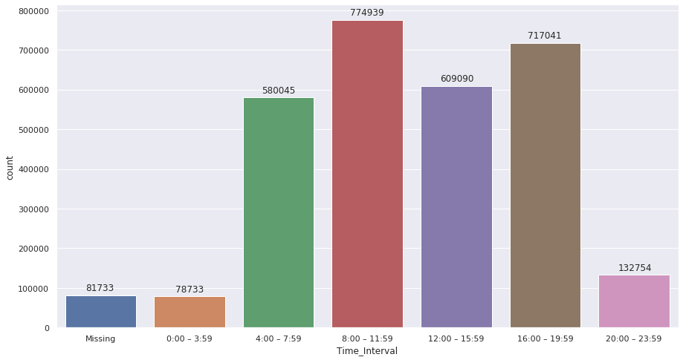
DATA CLEANSING
FEATURE ENGINEERING
PIPELINING AND TRAINING
RESULTS
Splitting and Bucketing
Understanding the time interval with the highest rate of accidents
Splitting the "Start_Time" feature to get the time
Bin 1: 0:00 am – 3:59 am / 0:00 – 3:59
Bin 2: 4:00 am – 7:59 am / 4:00 – 7:59
Bin 3: 8:00 am – 11:59 am / 8:00 – 11:59
Bin 4: 12:00 am – 3:59 pm / 12:00 – 15:59
Bin 5: 4:00 pm – 7:59 pm / 16:00 – 19:59
Bin 6: 8:00 pm – 11:59 pm / 20:00 – 23:59
Findings
Peak between 8:00/11:59 and 16/19:59 due to the traffic given by commuting
Peak between 12:00/15:59 probabily due to working breaks

Slide 15
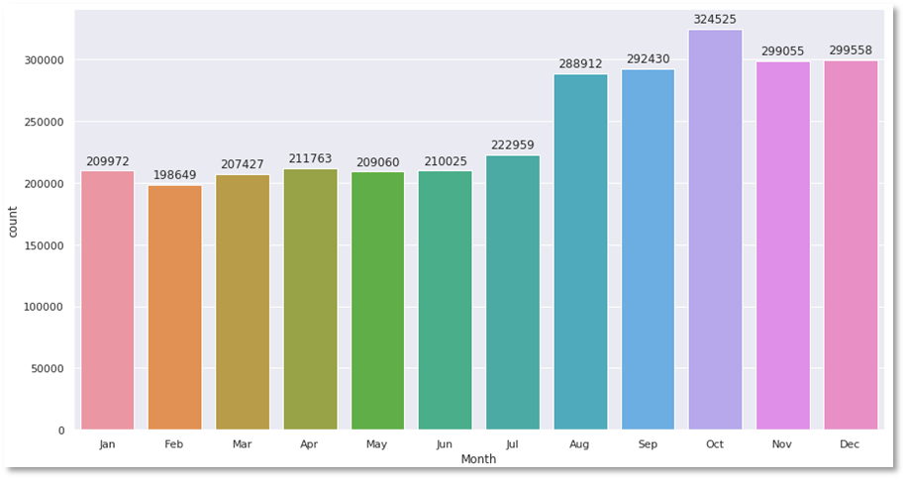
DATA CLEANSING
FEATURE ENGINEERING
PIPELINING AND TRAINING
RESULTS
Splitting and Bucketing
Searching for the month with the highest rate of accidents
Splitting the "Start_Time" feature to get the date
Get the month as number and mapping it as a name
Findings
May the accidents in the second half of the year rose due to the increasing traffic local tourism traffic (summer/winter vacation) or for heavier atmosphere events?

Slide 16






DATA CLEANSING
FEATURE ENGINEERING
PIPELINING AND TRAINING
RESULTS
Splitting and Bucketing
Bucketing weather conditions to reduce complexity
Light Rain Shower / Windy
Freezing Rain / Windy
Showers in the Vicinity
Rain Shower
Light Freezing Rain
Light Rain with Thunder
Heavy Rain / Windy
Rain Showers
Thunderstorms and Rain
Drizzle
Freezing Rain
Heavy Drizzle
Heavy Thunderstorms and Rain
Light Drizzle / Windy
Light Freezing Drizzle
Light Rain Showers
Heavy Freezing Drizzle
Heavy Rain
Rain / Windy
Heavy Freezing Rain
Light Rain
Heavy Rain Showers
Light Thunderstorms and Rain
Light Rain / Windy
Rain
Light Freezing Rain / Windy
Light Drizzle
Drizzle / Windy
Light Rain Shower
Heavy Blowing Snow
Small Hail
Heavy Snow / Windy
Light Snow and Sleet
Snow and Sleet
Snow / Windy
Snow and Thunder
Thunder / Wintry Mix / Windy
Thunderstorms and Snow
Light Snow Shower
Hail
Light Snow Showers
Snow
Light Snow Grains
Light Snow and Sleet / Windy
Light Snow
Heavy Snow
Light Thunderstorms and Snow
Snow and Sleet / Windy
Heavy Snow with Thunder
Blowing Snow / Windy
Heavy Ice Pellets
Patches of Fog
Fog
Partial Fog
Light Freezing Fog
Smoke / Windy
Light Haze
Haze / Windy
Partial Fog / Windy
Smoke
Drizzle and Fog
Fog / Windy
Light Fog
Mist
Haze
Partly Cloudy
Mostly Cloudy
Fair
Light Thunderstorm
Heavy T-Storm / Windy
Thunder
Partly Cloudy / Windy
Thunder in the Vicinity
Overcast
Fair / Windy
Mostly Cloudy / Windy
Ice Pellets
Light Snow with Thunder
Light Sleet
Light Snow / Windy
Wintry Mix / Windy
Wintry Mix
Sleet
Blowing Snow
Low Drifting Snow
Heavy Thunderstorms and Snow
Light Blowing Snow
Thunder and Hail / Windy
Snow Grains
Heavy Sleet
Snow Showers
Heavy Thunderstorms with Small Hail
Light Hail
Light Ice Pellets
Funnel Cloud
Squalls
Squalls / Windy
Tornado
N/A Precipitation
Cloudy
null
Clear
Thunder / Windy
Scattered Clouds
Cloudy / Windy
T-Storm / Windy
T-Storm
Heavy T-Storm
Sand / Dust Whirlwinds / Windy
Volcanic Ash
Widespread Dust / Windy
Widespread Dust
Sand
Dust Whirls
Blowing Dust
Blowing Sand
Blowing Dust / Windy
Sand / Dust Whirlwinds
Shallow Fog
Heavy Smoke

Slide 17
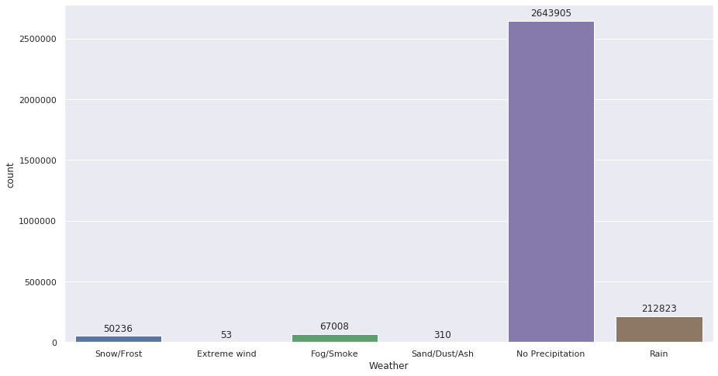
DATA CLEANSING
FEATURE ENGINEERING
PIPELINING AND TRAINING
RESULTS
Splitting and Bucketing
Bucketing weather conditions to reduce complexity
Light Rain Shower / Windy
Freezing Rain / Windy
Showers in the Vicinity
Rain Shower
Light Freezing Rain
Light Rain with Thunder
Heavy Rain / Windy
Rain Showers
Thunderstorms and Rain
Drizzle
Freezing Rain
Heavy Drizzle
Heavy Thunderstorms and Rain
Light Drizzle / Windy
Light Freezing Drizzle
Light Rain Showers
Heavy Freezing Drizzle
Heavy Rain
Rain / Windy
Heavy Freezing Rain
Light Rain
Heavy Rain Showers
Light Thunderstorms and Rain
Light Rain / Windy
Rain
Light Freezing Rain / Windy
Light Drizzle
Drizzle / Windy
Light Rain Shower
Heavy Blowing Snow
Small Hail
Heavy Snow / Windy
Light Snow and Sleet
Snow and Sleet
Snow / Windy
Snow and Thunder
Thunder / Wintry Mix / Windy
Thunderstorms and Snow
Light Snow Shower
Hail
Light Snow Showers
Snow
Light Snow Grains
Light Snow and Sleet / Windy
Light Snow
Heavy Snow
Light Thunderstorms and Snow
Snow and Sleet / Windy
Heavy Snow with Thunder
Blowing Snow / Windy
Heavy Ice Pellets
Patches of Fog
Fog
Partial Fog
Light Freezing Fog
Smoke / Windy
Light Haze
Haze / Windy
Partial Fog / Windy
Smoke
Drizzle and Fog
Fog / Windy
Light Fog
Mist
Haze
Partly Cloudy
Mostly Cloudy
Fair
Light Thunderstorm
Heavy T-Storm / Windy
Thunder
Partly Cloudy / Windy
Thunder in the Vicinity
Overcast
Fair / Windy
Mostly Cloudy / Windy
Binning in six different categories
Ice Pellets
Light Snow with Thunder
Light Sleet
Light Snow / Windy
Wintry Mix / Windy
Wintry Mix
Sleet
Blowing Snow
Low Drifting Snow
Heavy Thunderstorms and Snow
Light Blowing Snow
Thunder and Hail / Windy
Snow Grains
Heavy Sleet
Snow Showers
Heavy Thunderstorms with Small Hail
Light Hail
Light Ice Pellets
Snow/Frost
Extreme wind
Fog/Smoke
Sand/Dust/Ash
No Precipitation
Rain
Funnel Cloud
Squalls
Squalls / Windy
Tornado
N/A Precipitation
Cloudy
null
Clear
Thunder / Windy
Scattered Clouds
Cloudy / Windy
T-Storm / Windy
T-Storm
Heavy T-Storm
Shallow Fog
Heavy Smoke
Sand / Dust Whirlwinds / Windy
Volcanic Ash
Widespread Dust / Windy
Widespread Dust
Sand
Dust Whirls
Blowing Dust
Blowing Sand
Blowing Dust / Windy
Sand / Dust Whirlwinds
Findings
Great part of accidents when no precipitations are present
Rain as second condition

Slide 18
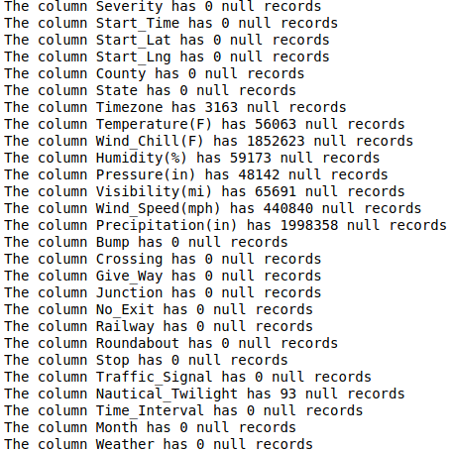
Dealing with uncomplete data
1) Finding the remaining 93 values for “Nautical_Twilight“
Useful to classify whether the accident has happened during “Day“ or “Night“ light conditions.
2) Finding the weather parameters missing
In supposition that these parameters have huge weight in driving conditions

Slide 19
Dealing with uncomplete data
Finding the remaining 93 values for “Nautical_Twilight“
Retrieving the timezone name
Getting the time offset
Getting the time of nautical sunrise and sunset of the day of the crash
Comparing the time of crash to the nautical sunrise/sunset
Obtaining the value "Day" or "Night" for the crash
Obtaining the value "Day" or "Night" for the crash and storing it back to the dataframe
Use of “TimezoneFinder“ which is a library that given the coordinates, gives back the timezone in terms of geographical location, such as America/Detroit or Europe/Istanbul
Use of “BeautifulSoap” library to get from Wikipedia by webscrapping the corresponding offset of the timezones found, such as −05:00 or +03:00
Getting the nautical sunrise and sunset time of the day in which the crash happened using the Astropy library
Comparing the time of crash (adjusted with time offset) to the nautical sunrise/sunset

Slide 20
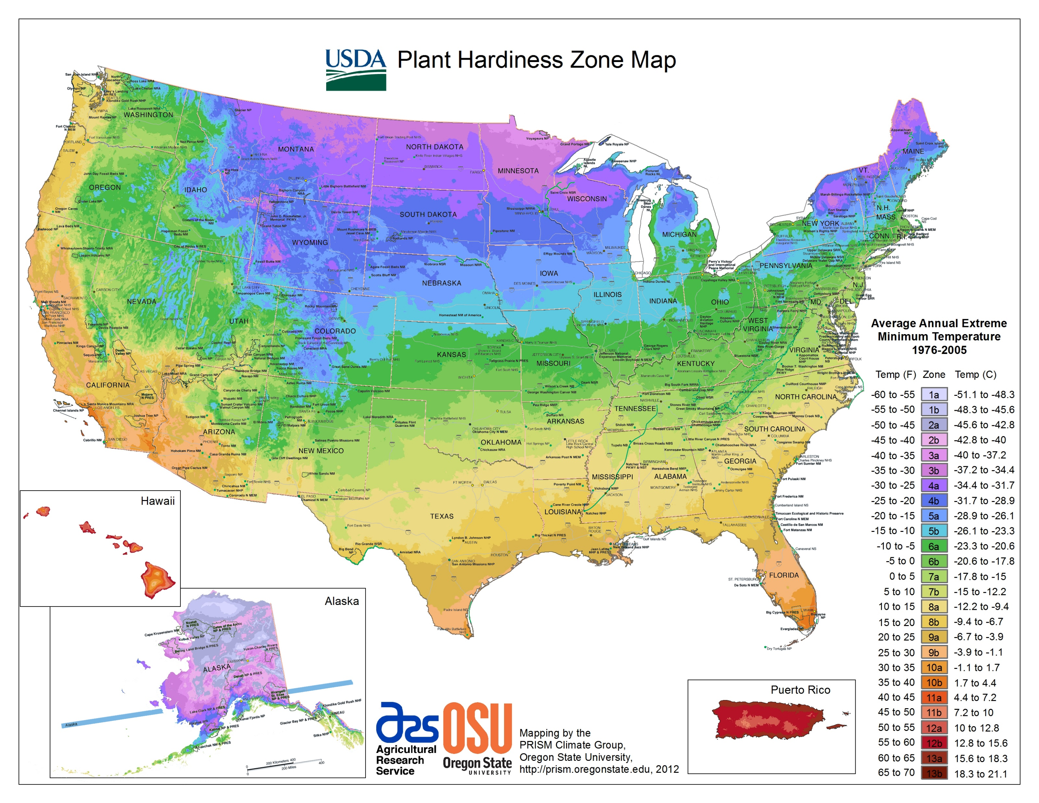
Dealing with uncomplete data
Filling the null values of weather parameters
Naïve solution: averaging the parameters not null
Problem
Agricoltural Research Services – Oregon State University

Slide 21
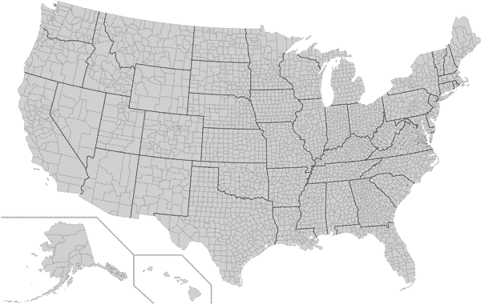
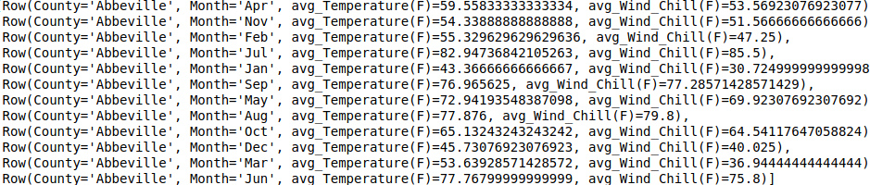
Dealing with uncomplete data
Filling the null values of weather parameters
Less naïve solution adopted: averaging by county and month

Slide 22
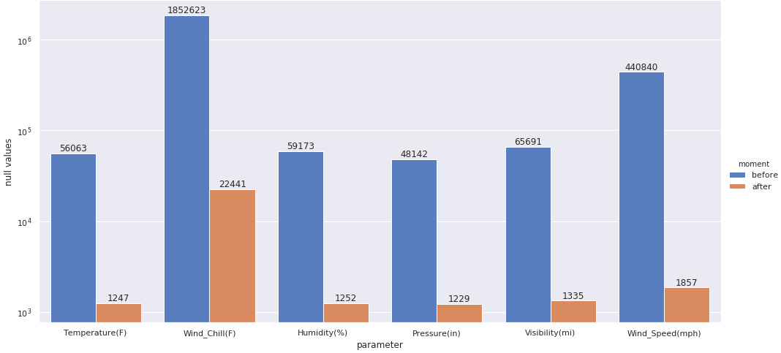
Dealing with uncomplete data
Filling the null values of weather parameters
The remaining 19227 null values affect the 0.69% circa of the total entries, then they’ve been deleted.

Slide 23
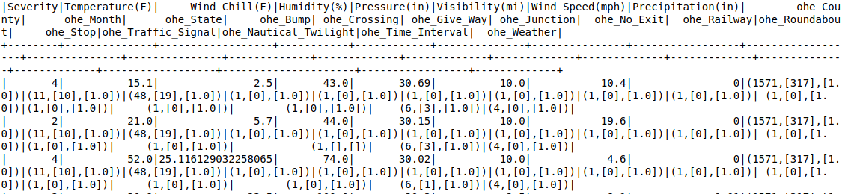

DATA CLEANSING
FEATURE ENGINEERING
PIPELINING AND TRAINING
RESULTS
Data preparation from training
Indexing/Label Encoding
One Hot Encoding
Splitting the dataset
Train
Test
Notes:
MlLib

Slide 24
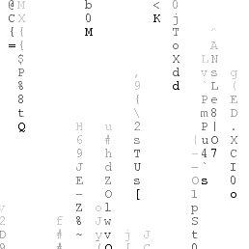
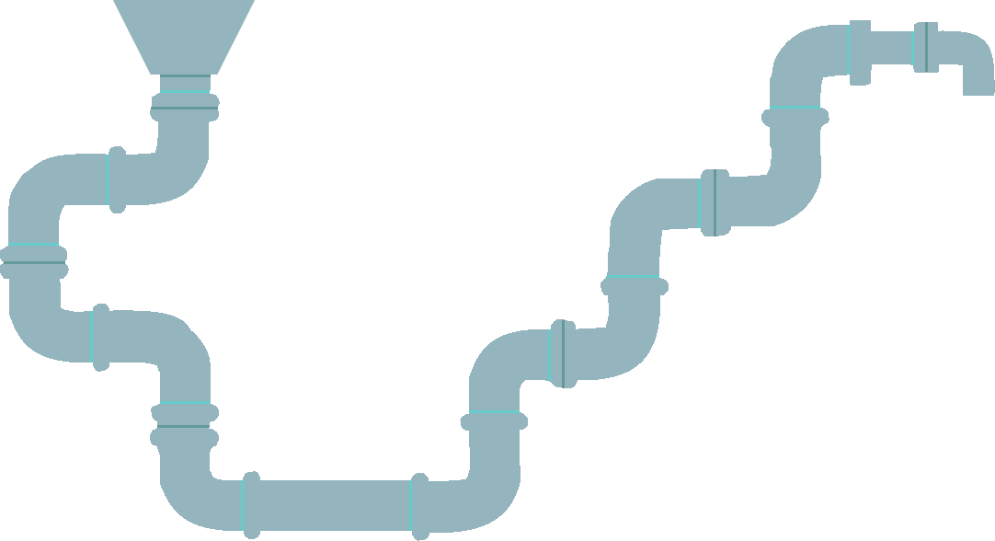




DATA CLEANSING
FEATURE ENGINEERING
PIPELINING AND TRAINING
RESULTS
Pipeline is an API implemented in Spark useful to concatenate different data transformation and machine learning functions in a stage-after-stage workflow fashion
Training
Vector Assembling pt2
Vector Assembling pt1
Standard Scaling
Model

Slide 25
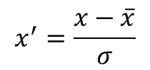
DATA CLEANSING
FEATURE ENGINEERING
PIPELINING AND TRAINING
RESULTS
Steps of the pipeline
Vector Assembling pt1
Standard Scaling
Vector Assembling pt2
Aggregates the features of atmospheric parameters to permit the use of standard scaling
Scales the atmosperic parameters using standardization formula
Aggregates the features of atmospheric parameters with the vector of One Hot Encoded categorical features as a precondition for training
A data-driven analysis for car accident characteristics in U.S. using Apache Spark
$$x^{′}=\frac{x−\overline{x}}{σ}$$

Slide 26
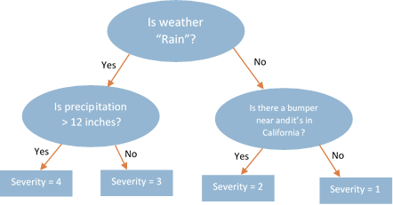
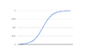
DATA CLEANSING
FEATURE ENGINEERING
PIPELINING AND TRAINING
RESULTS
Steps of the pipeline
Training
Decision Tree
Random Forest
One-vs-Rest
A data-driven analysis for car accident characteristics in U.S. using Apache Spark
Maximum depth [3, 6]
Maximum depth [5, 10]
Number of trees [5, 10]
Use of logistic regression
Maximum iterations [5, 10]
Fit intercept (True, False)

Slide 27
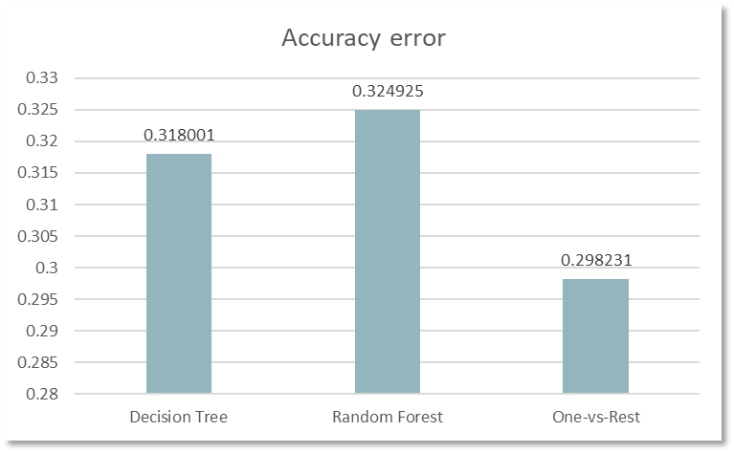
DATA CLEANSING
FEATURE ENGINEERING
PIPELINING AND TRAINING
RESULTS
Evaluation of the results
Model error
Findings
The best result is given by the One-vs-Rest technique (supported by logistic regression)
The Random Forest performed worse than Decision Tree, perhaps for the non-optimal hyper parameterizing tuning

Slide 28

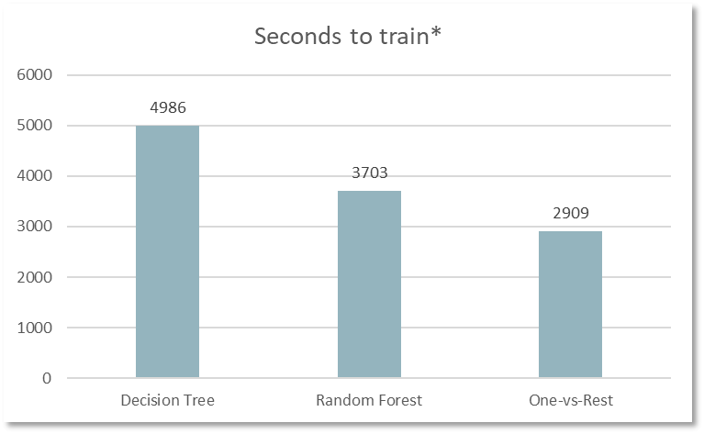


Evaluation of the results
Performances
* 2x head node, 4 vCPU - 28 GB RAM + 1x worker nodes, 4 vCPU - 28 GB RAM

Slide 29
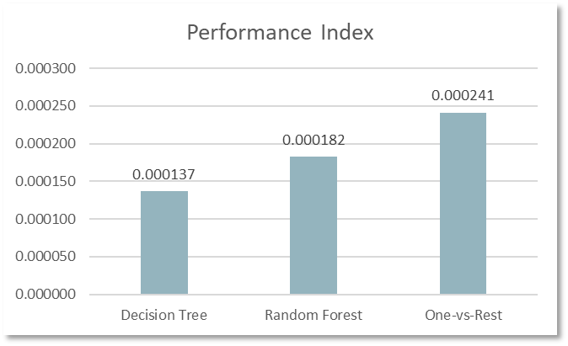
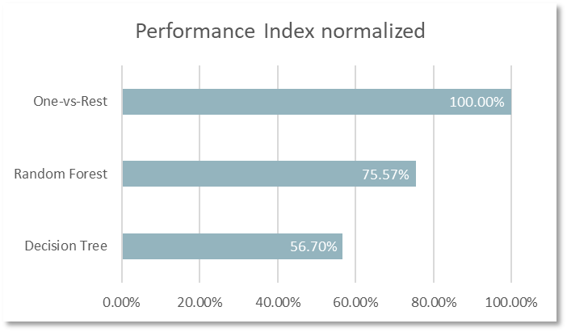
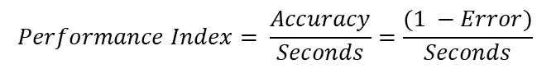
Evaluation of the results
From absolute to relative performances
$$Performance Index= \frac{Accuracy}{Seconds}=\frac{(1 −Error)}{Seconds}$$
$$Normalized Performance Index= \frac{{Performance Index}_{algorithm}}{{Performance Index}_{One−vs−Rest}}∗100$$

Slide 30
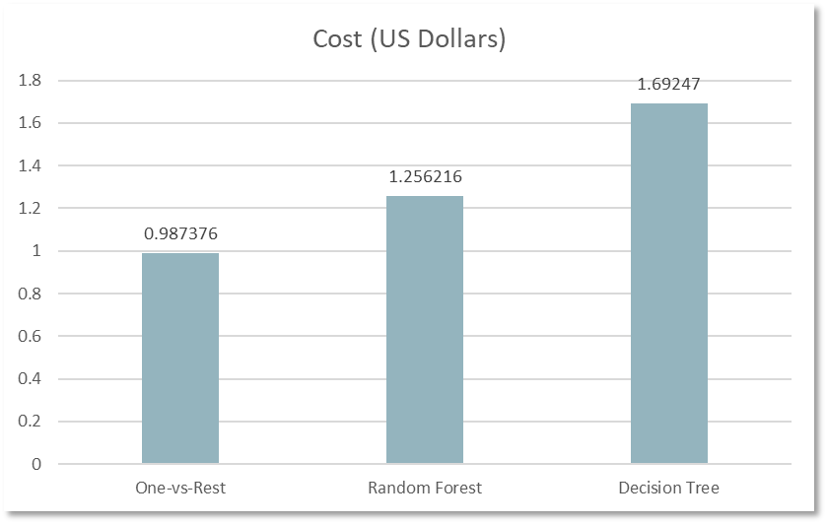
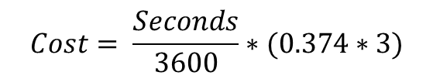
Evaluation of the results
Costs of training assessment
$$Cost= \frac{Seconds}{3600}∗(0.374∗3)$$
*As April 2020, Azure requires $ 0.374/hour for each D12 v2 instance (4 vCPUs + 28GB RAM)

Slide 31
Evaluation of the results
Conclusions
The best algorithm among the three tried, turned out to be the One-vs-Rest incapsulating Logistic Regression
Cheapest
Most accurate
Fastest to train
Unfortunately, an error overpassing 29% is not acceptable
Not a safe model if applied as a single technology to an automatic decision system onboard of a car, due to high risk of impacting on passenger, pedestrian and other driver
My be acceptable if used in a passive way by taking its result as a suggestion to the driver, or in conjunction to the rest of the sensors and processing systems to evaluate if the risk of increasing/decreasing the average speed is manageable.

Slide 32
Evaluation of the results
Margins of improvement
Wind direction and speed have been dropped from the dataset since there is no information about which direction the vehicle was facing at, papers on vehicle dynamics demonstrate that wind speed starts to affect cars lateral stability starting from 24 m/s with a moderate and steady driving style; so having that information could increase the reliability of the model.
Changing the paradigm of geo-spatial analysis switching from county as smallest area block to buffers centred on the car accident, clustering the area and assigning to the surroundings a proper number of risk index; so the vehicle coming into this area can have a more precise warning.
Obviously, the problem of having access to real time position of each car involves dealing with privacy limitations (different for each country) and with the huge traffic generate by moving vehicles as well as the robust infrastructure behind it.

Slide 33
Evaluation of the results
Margins of improvement
A further future-proof workflow is gathering more road characteristics just using the integrated camera placed behind the windshield of the vehicle, reading the scene and labelling the objects it sees: this way it will possible to intersect, for example, this data with the description of the accident in that area (reported in the column “Description” of the dataset).
In order to extend the experimentation, pressing on the One-vs-Rest algorithm using different classification techniques (due to the good performance reached in comparison to the other two) and parametrizing them with a higher variety of hyperparameters can be useful.
A data-driven analysis for car accident characteristics in U.S. using Apache Spark

Slide 34
A data-driven analysis for car accident characteristics in U.S. using Apache Spark
Thank you for your attention
Gabriele Favia – matr. 579166
Big Data – Politecnico di Bari 19/20

